Slide 1
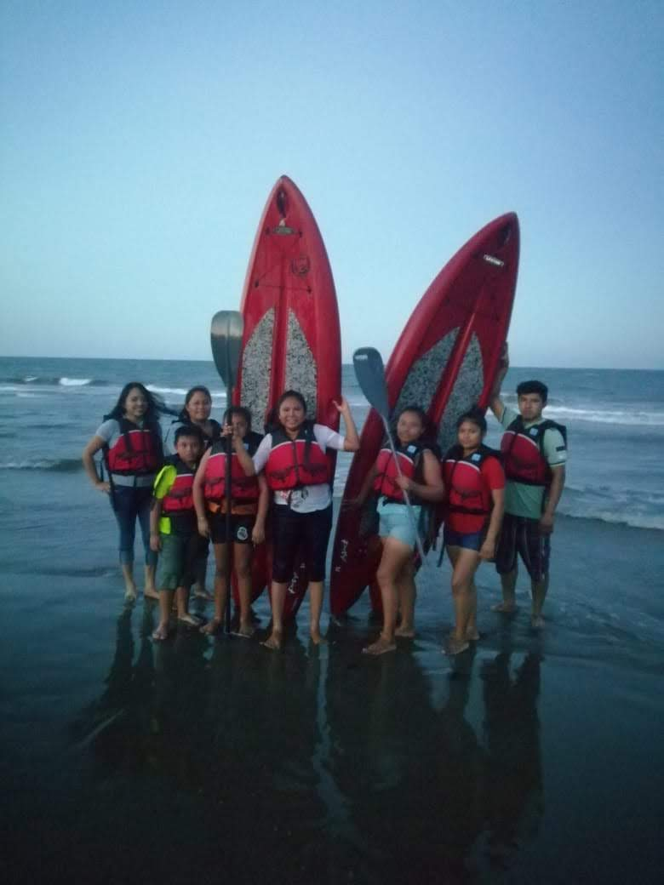
Ecoturismo en los Arrecifes de los Tuxtlas Ecoturism in the Tuxtlas Reefs
Responsable Técnica: María Susana Rocha Mier
Asesora WiNN: Ana Liz Flores

Slide 2
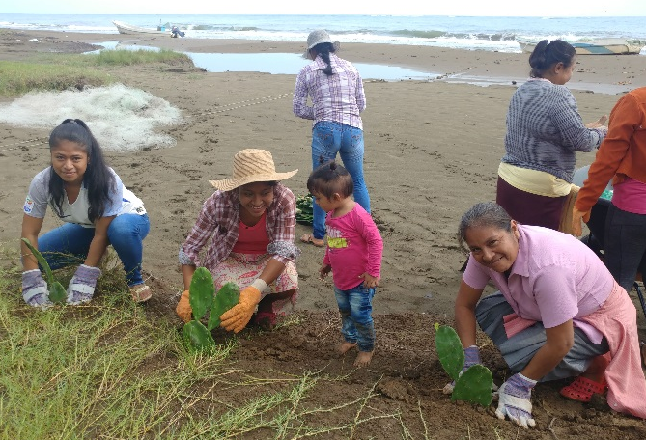
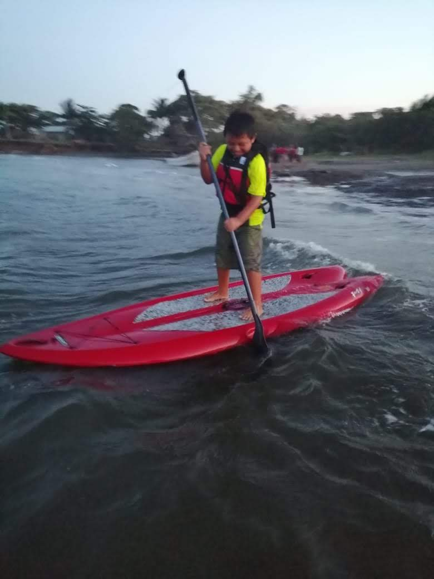
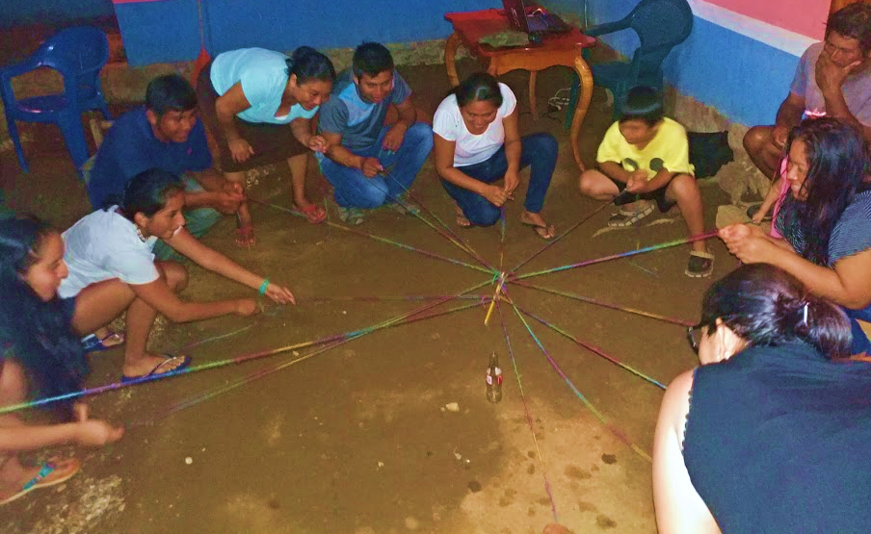
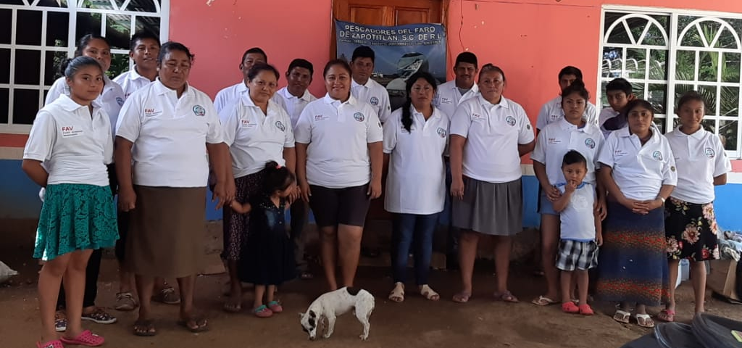
OBJECTIVE:
Generate a sustainable alternative source of income for the indigenous fishermen of Zapotitlán, promoting the care of the marine and coastal ecosystems of the Los Tuxtlas Reefs.

Slide 3
Where we are

Slide 4
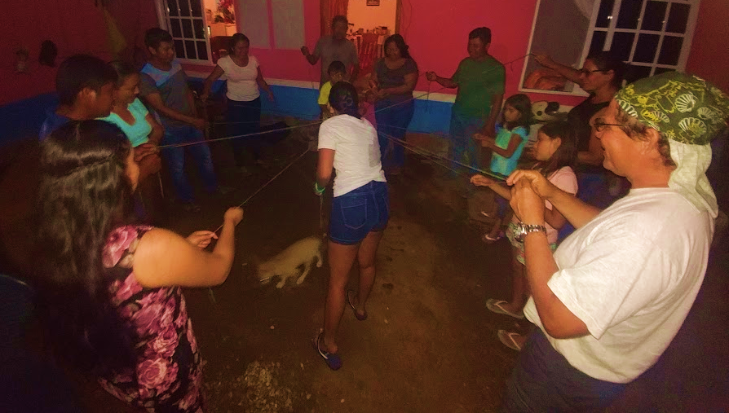
Components of the project
Environmental awareness and education.
Conservation and restoration of coastal ecosystems.
Equipment and training to provide tourist services.

Slide 5
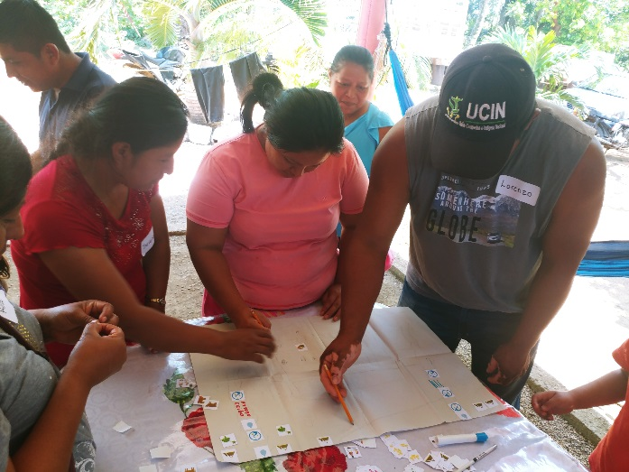
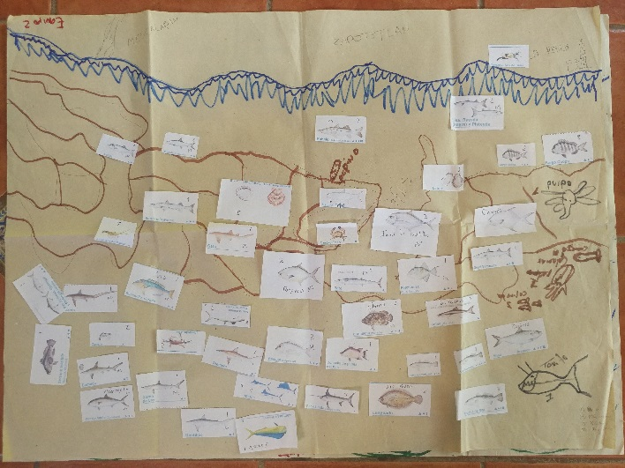
1. Environmental awareness and education.
In this component we learned more about the situation of our marine and coastal ecosystems. We have the advice of Dr. Verónica Valadez, from the Technological Institute of Boca del Río.

Slide 6
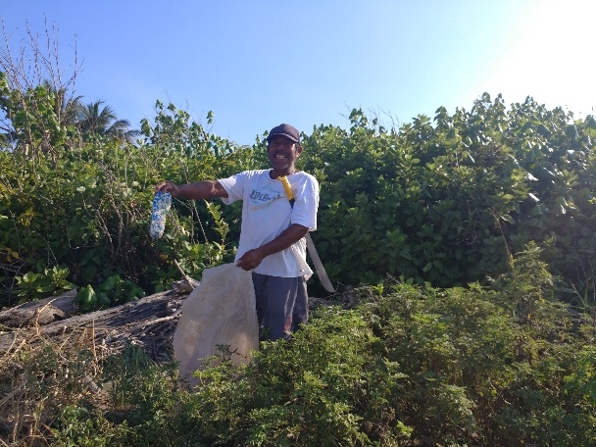
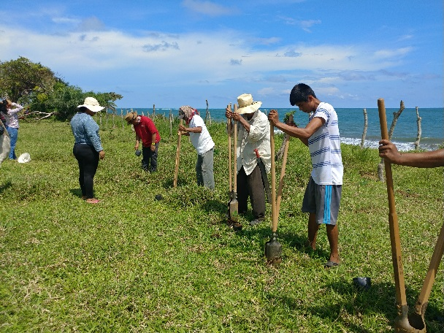
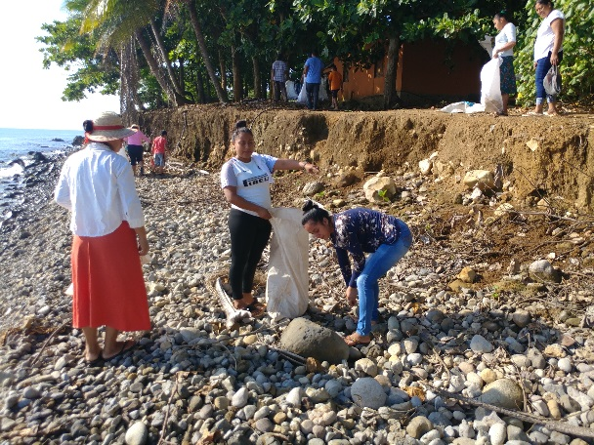
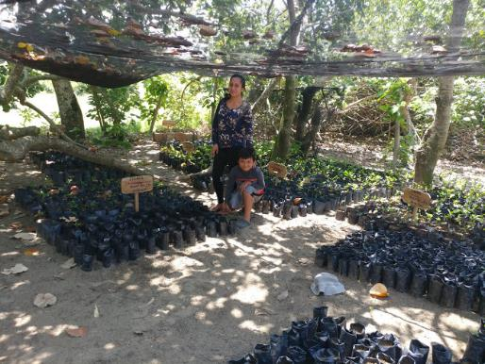
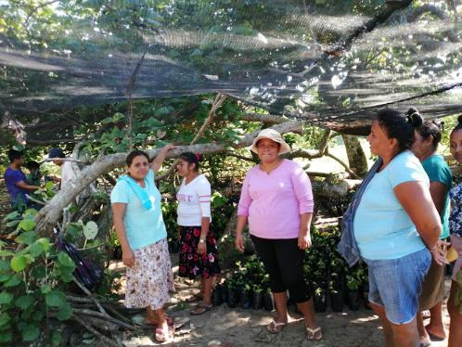
2. Conservation and restoration of coastal ecosystems.
In this component, we started a nursery with dune species to reforest. Beach and dune cleanings were also carried out.

Slide 7
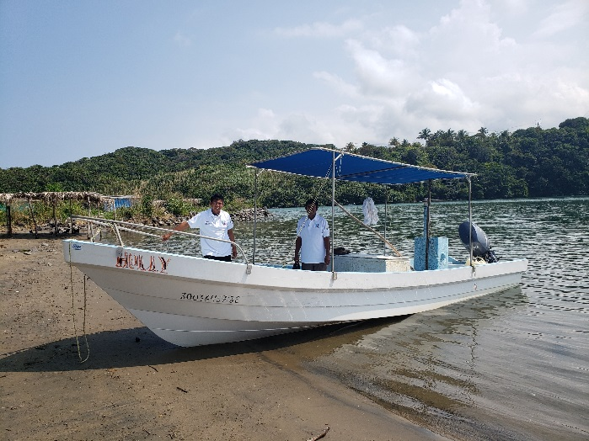
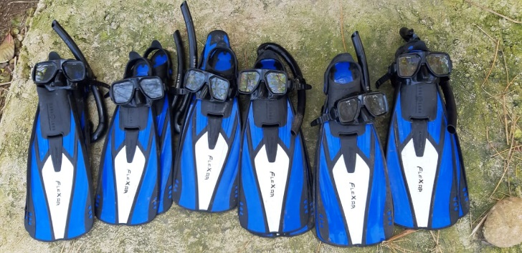
3. Equipment and training to provide tourist services.
In this component, kayaks, boards, snorkel goggles, fins were purchased, and a boat was equipped to provide tourist services. We are trained in Regulation 06 on the requirements for tourist camps, and Regulation 011 that contemplates Adventure Tourism requirements.

Slide 8
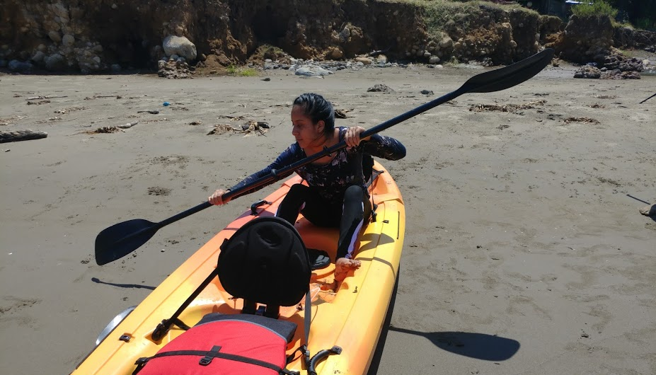
Actions to include women in the project
We had special clases for the women to learn to use the kayak, the paddle board, and to practice snorkeling.

Slide 9
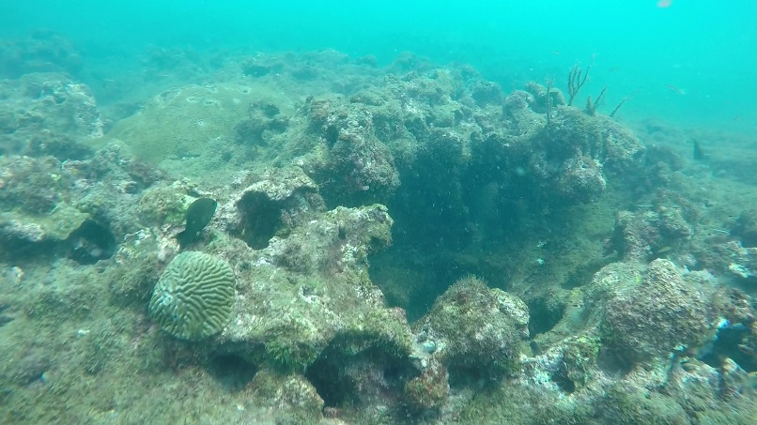
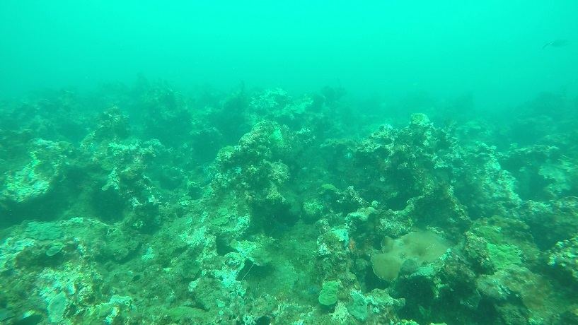
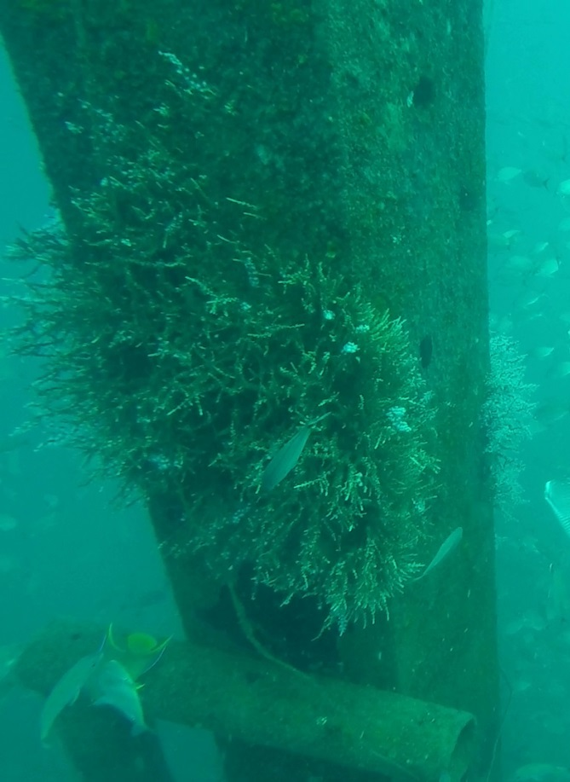
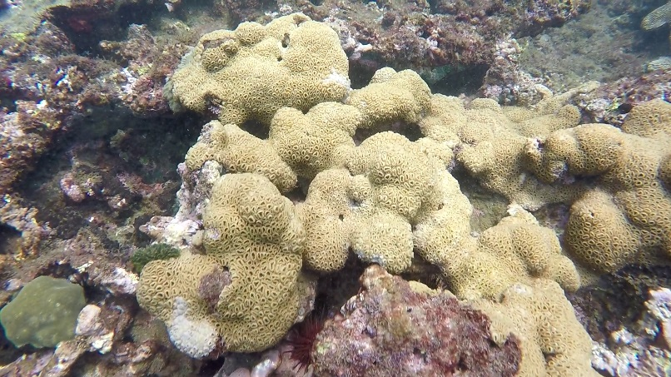
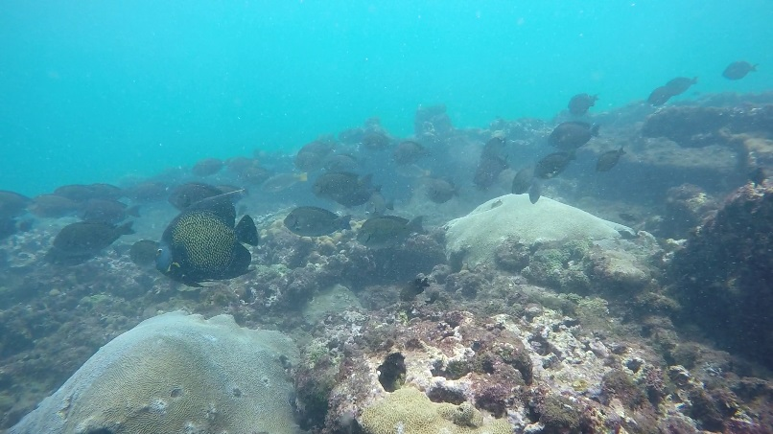
We also explore new dive and recreation sites, with conservation.

Slide 10
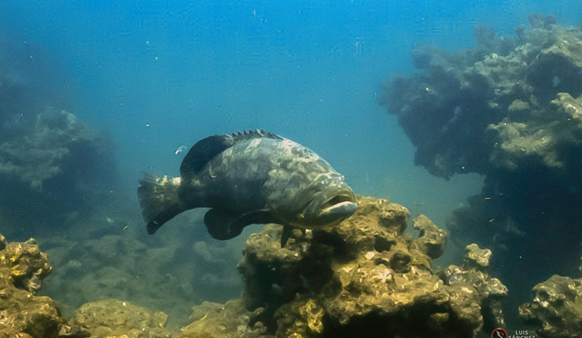
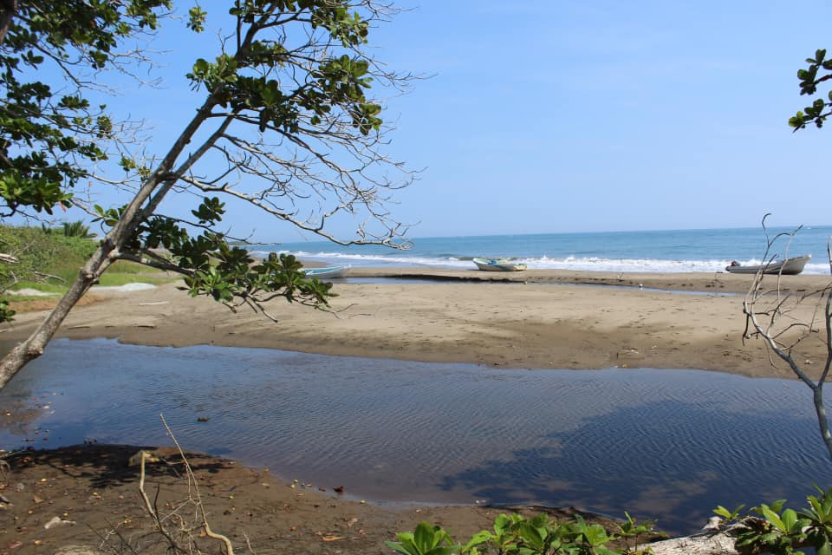
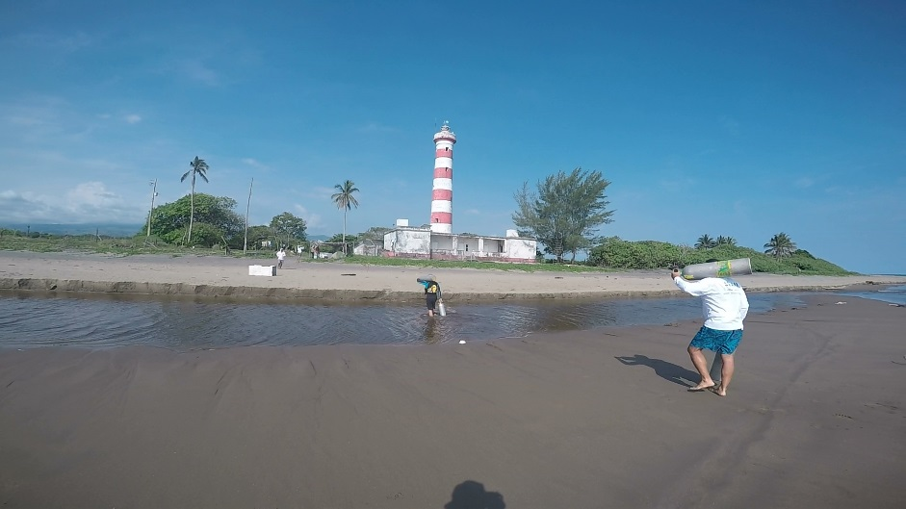
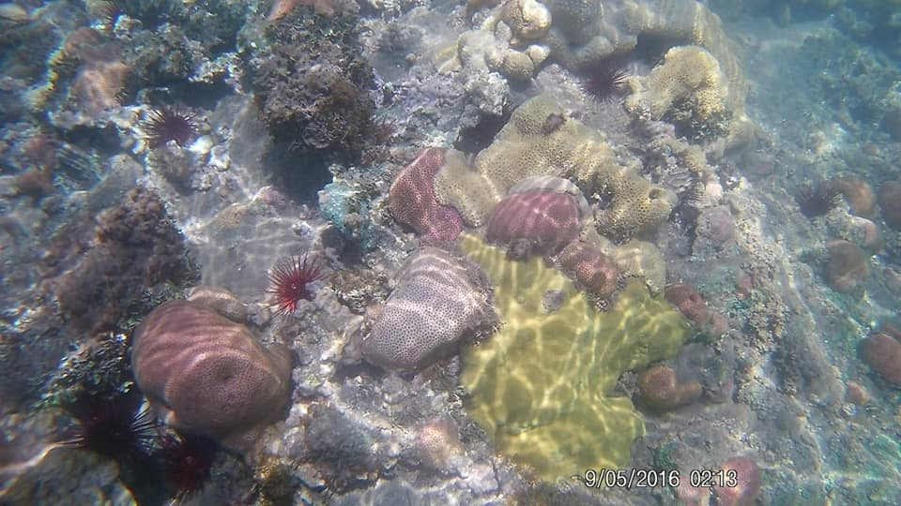
We know that we have special resources and we want to take care of them, because we can PRODUCE CONSERVING AND CONSERVE PRODUCING.

Slide 11
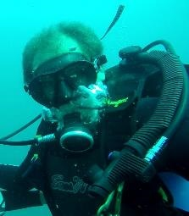
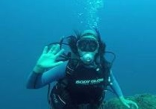
Technical team
ING. Ricardo Antonio Álvarez Hernández
AVENTUX
aventux.ricardo@Gmail.com
M.E.E. María Susana Rocha Mier
Gente Sustentable A.C.
srochamier@gmail.com

Slide 12
Special thaks to
Dra. Verónica Valadez Rocha
Boca del Río Technological Institute
Dra. Ana Liz Flores
Sister WiNN
International consultant specializing
in local development
FOR THEIR GENEROUS SUPPORT AND ADVICE FOR THIS PROJECT

